Slide 1
Workshop 1: Modulært byggeri
Potentialer og barrierer ved modulært byggeri fremfor traditionelt byggeri – og årsager til modulært byggeris lavere udbredelse i Danmark
3. Oktober 2023

Slide 2
Program
11:30 Velkomst, sandwiches og netværk
11:50 Introduktion til modulært byggeri og researchprojektet v Mayes Ali, ConTech Lab
12:00 Oplæg: Hvad er modulært byggeri? Hvad sker der i vores nabolande? V Jerker Lessing, Stanford University
12:45 Gruppediskussion: Hvad er potentialet ved modulært byggeri? v Kristian Bork, WE BUILD DENMARK
13:20 Kort pause
13:35 Oplæg: Oversigt over modulbyggevirksomheder v Mayes Ali, ConTech Lab
13:45 Gruppediskussion: Hvorfor er modulbyggeri ikke mere udbredt i Danmark? Hvilke faktorer spiller ind? Hvad kan vi gøre anderledes? v Kristian Bork, WE BUILD DENMARK
14:45 Opsamling og Tak for i dag v Mayes Ali, ConTech Lab og Kristian Bork, WE BUILD DENMARK

Slide 3
Formål med workshop 1
Introduktion til modulært byggeri og diskutere dets potentiale samt identificere de vigtigste barrierer for dets udbredelse sammenlignet med traditionelt byggeri.

Slide 4
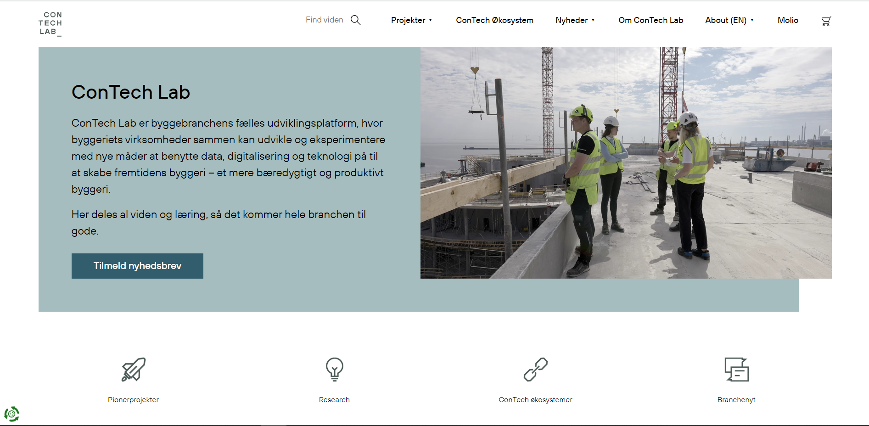
Notes:
ConTech Lab
ConTech lab er byggebranchens fælles udviklingsplatform, eller innovationshub om man vil, hvor byggeriets virksomheder sammen kan udvikle og eksprimentere med nye måder at benytte data, digitaliserign og teknologi på – til at skabe et mere bæredygtigt og produktivt byggeri.
Fokusområder.
Vi arbejder primært indenfor fire områder:
Prionerprojektet.
Research
ConTech Økosystemer
Branchenyt

Slide 5
Formål med research projekt om modulært byggeri
I samarbejde med Realdania By og Byg, undersøger ConTech Lab og WE BUILD DENMARK modulbyggeriets potentiale for effektive og mere bæredygtige bygninger.
Danmark har været tilbageholdende med industrialiseret byggeri, mens andre europæiske lande har omfavnet det.
Vores research projekt vil sammenligne modulbyggeri med traditionelle metoder og undersøge hele byggeprocessen. Vi fokuserer geografisk på tilgængelige markeder som Skandinavien, de baltiske lande, Nordtyskland og Holland.

Slide 6
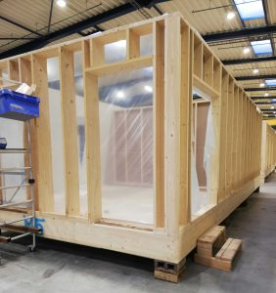
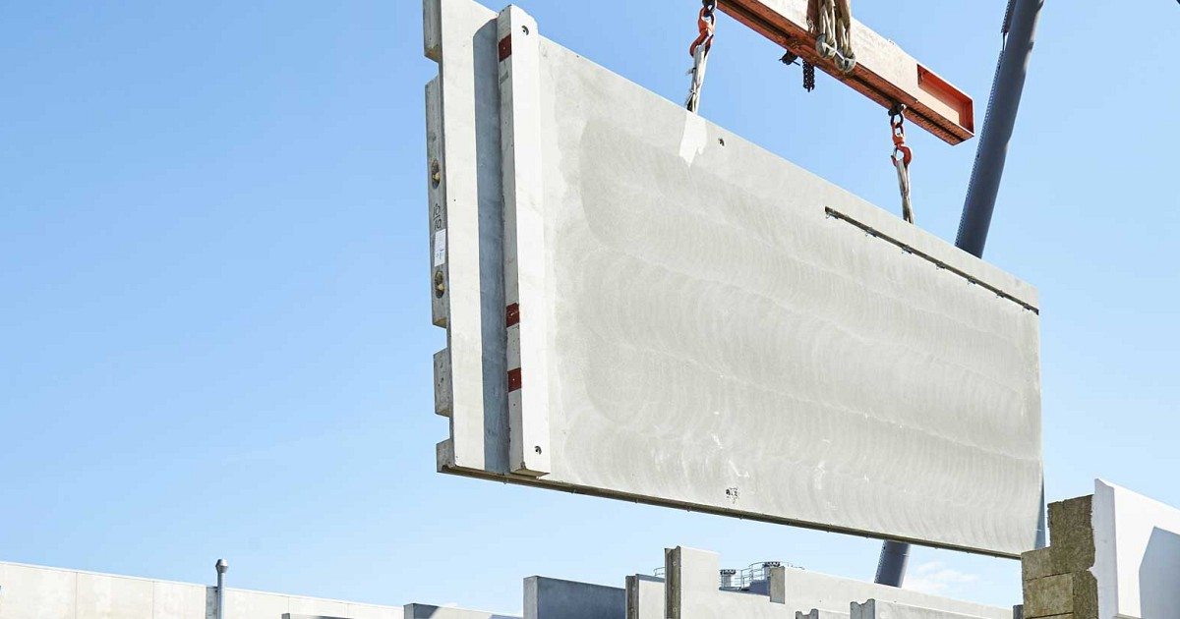
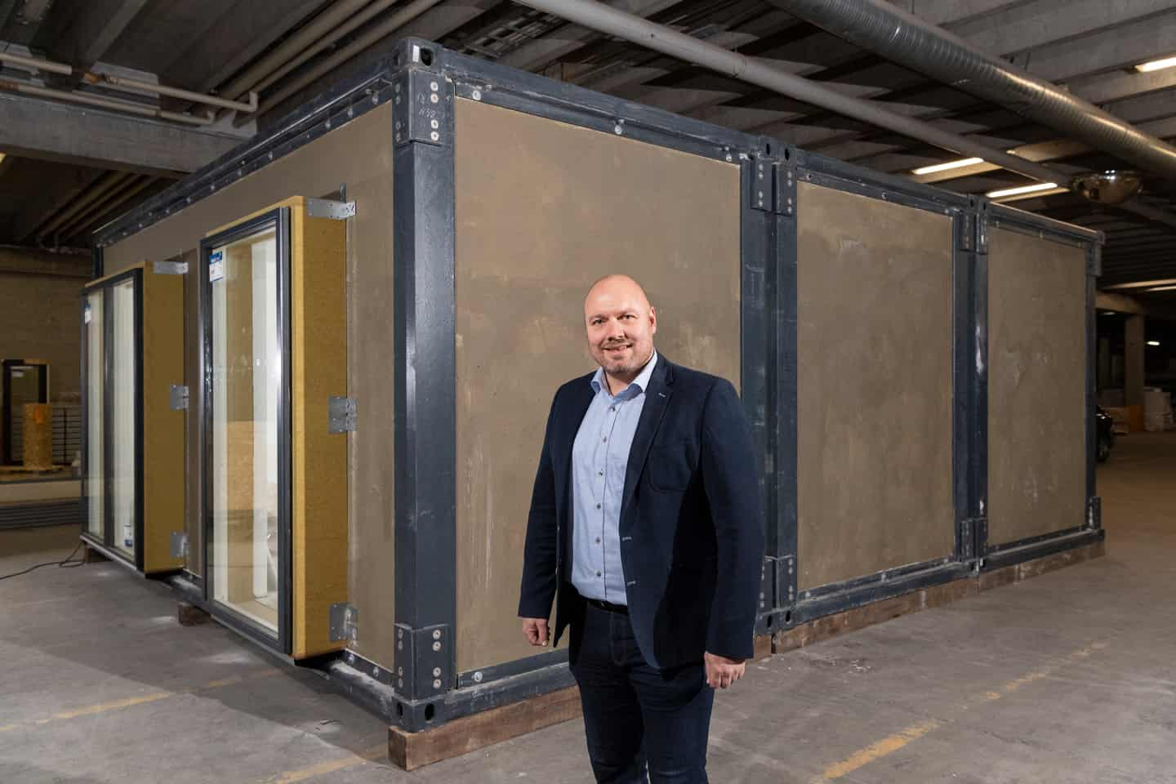
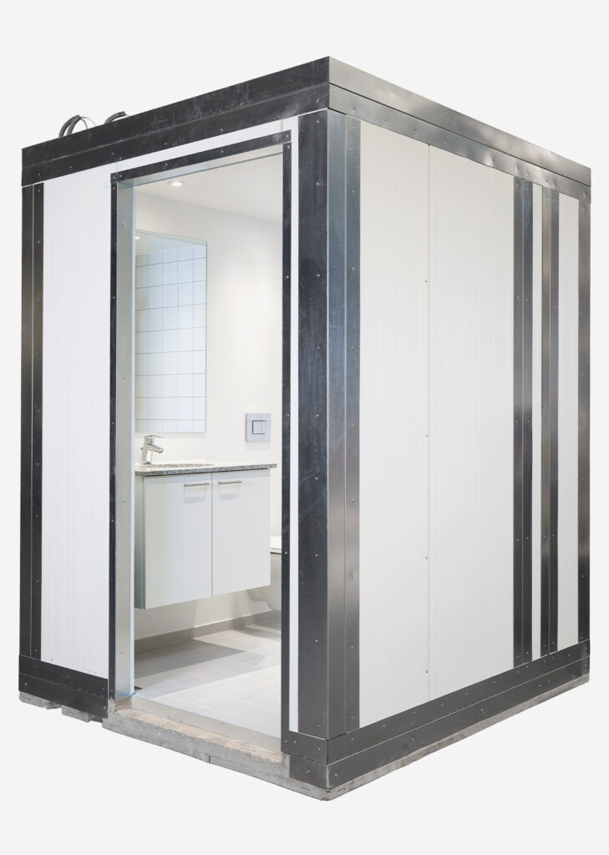
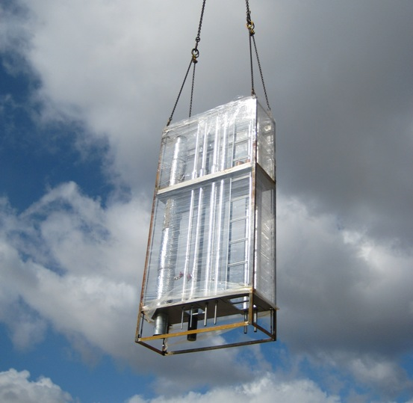
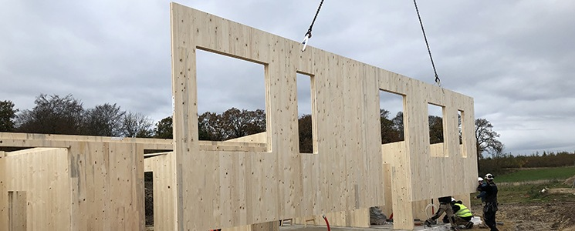
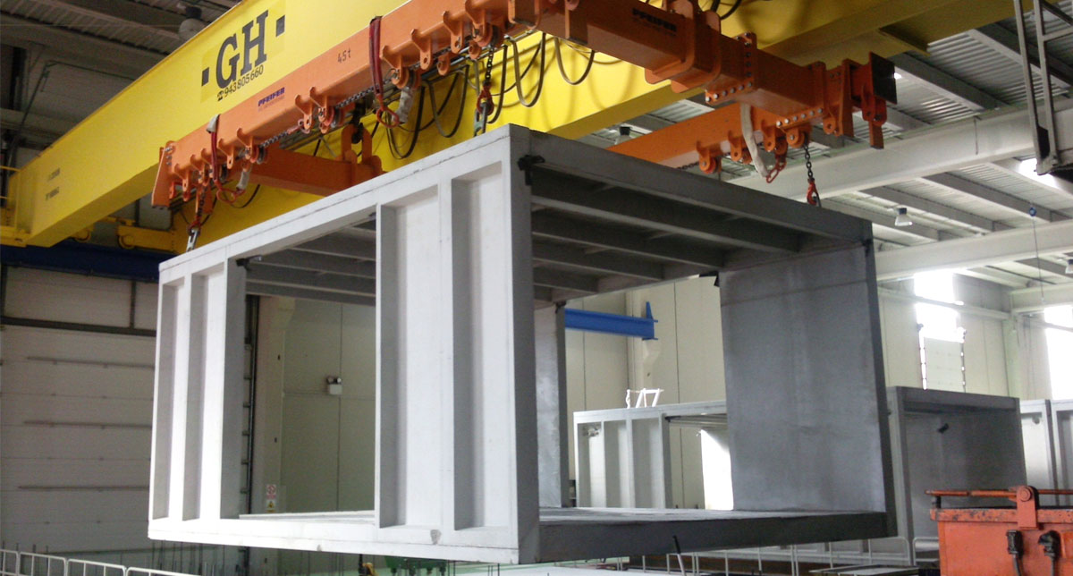
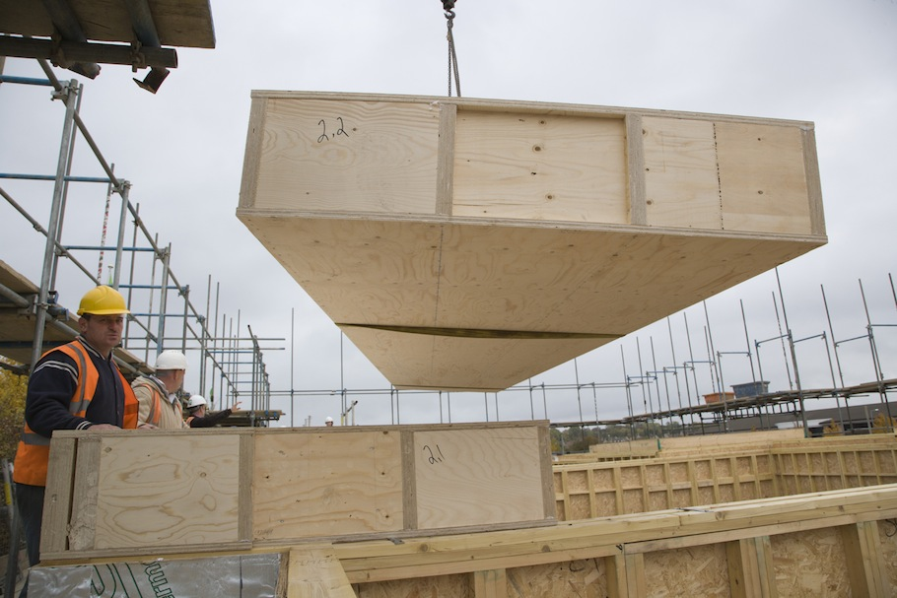
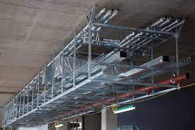
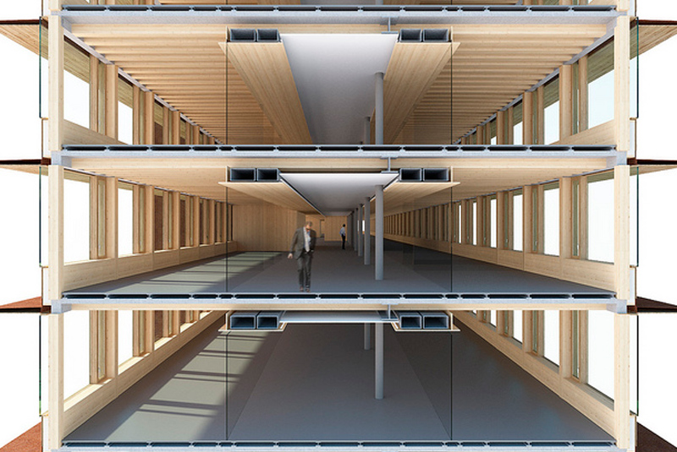
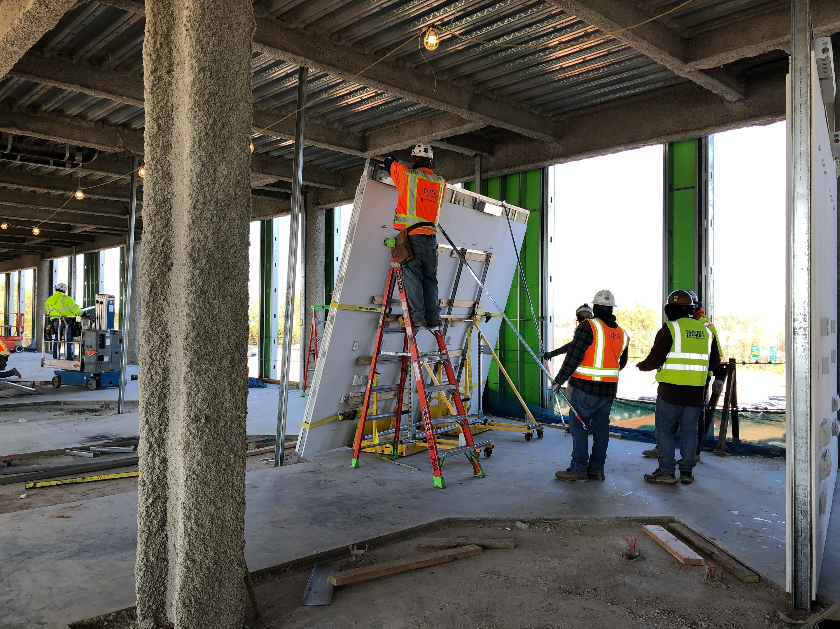
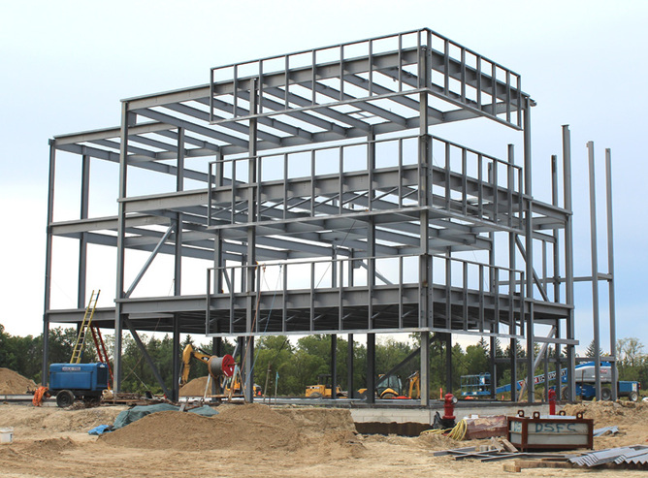
Hvad menes med modulært byggeri? - Research framework
Container store moduler
Funktionsmoduler
Byggesystemer
Træ
Beton
Stål
Badekabiner
CLT
Kerto
Føringsveje
Skakte
CREE
Beton
Stål
Indervægge
6

Slide 7
Evalueringskriterier
Anskaffelsesomkostninger
Driftsomkostninger
LCA inkl A4 og A5
Produktionstid
Tidsplan
Kvalitet
Arbejdsmiljø / Sikkerhed
Bæredygtighed
Funktionalitet

Slide 8
Hvad er modulært byggeri og hvad sker der i vores nabolande?
Jerker Lessing, Stanford University

Slide 9
Industrialized Construction

Slide 10
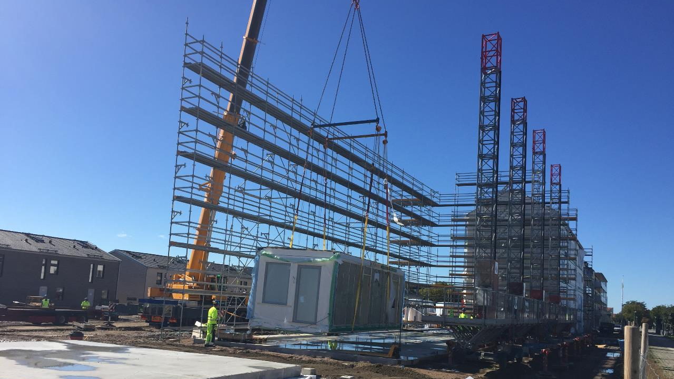
Introduction to Industrialized Construction

Slide 11
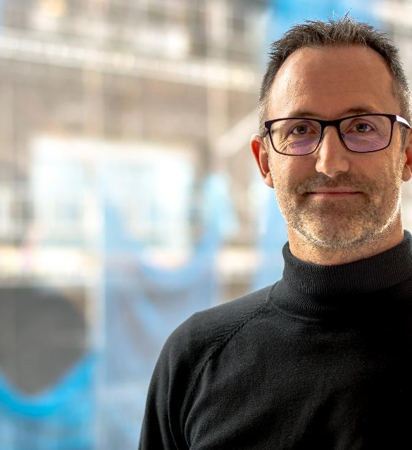
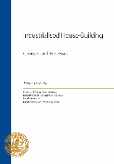
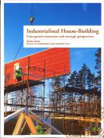
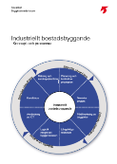
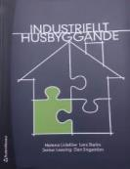
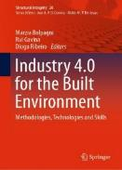
Jerker Lessing
Adjunct Professor, Stanford University
Advisor and consultant within Industrialized Construction
Head of research & Development, BoKlok 2015 - 2023
PhD from Lund University, Sweden. Topic: Industrialized Construction
Consultant at Tyréns and Prolog; Building systems and Supply Chain Management

Slide 12
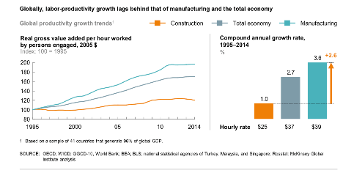
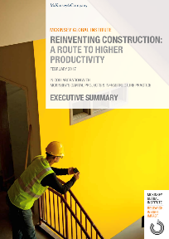
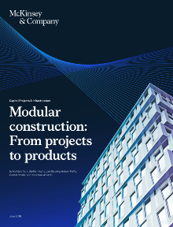
Industrialized Construction
A global movement!
Industrialized Construction gets attention globally
Great development last 15 years (Scandinavia, UK, Japan, USA, China, Singapore, Australia)
A common insight: Need for alternative to traditional construction
Need for improved productivity, less waste, shorter lead times, improved quality and lower costs
And not least: Radical improvements in sustainability is needed

Slide 13
- So, why do we need industrialized construction?

Slide 14
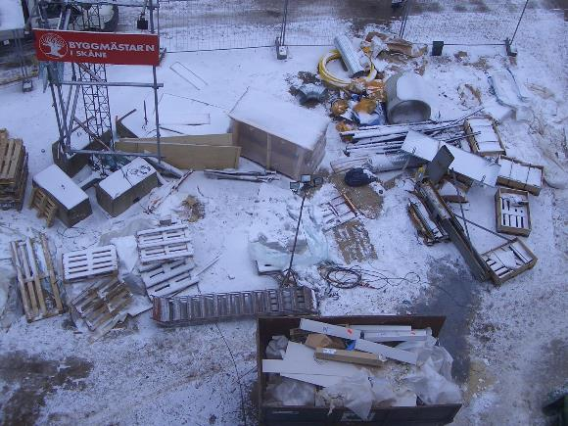
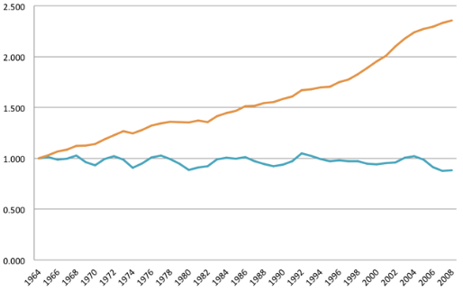
Value added per work hour has increased by 250% in manufacturing in the last 50 years, stayed flat in construction
Why we need to industrialize
Production facility
Safety
Labor Productivity for construction industry vs. all non-agricultural industries
Logistics
Sustainability
By Paul Teicholz
Based on U.S. Department of Commerce data

Slide 15
- So, what is industrialized construction?

Slide 16
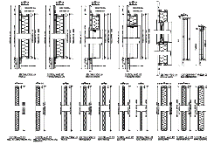
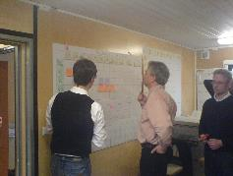
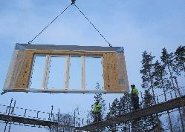
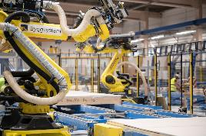
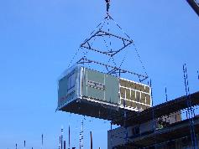
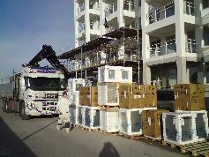
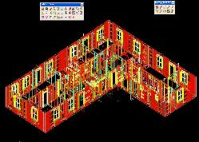
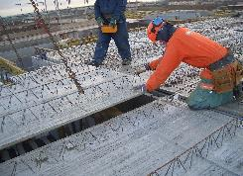
Customer and market fokus
Standardized solutions
Factory production
Continuous improvements
Planning
Prefabrication
Standardized processes
Automation
Building systems
Logistics
Use of digital tools
Long-term relations

Slide 17
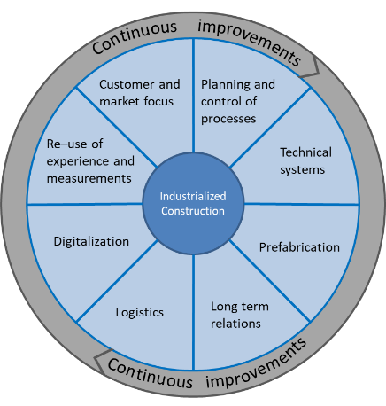
A topic that needs a framework
All pieces are needed and strengthen each other
Not only a production method
A holistic product- & production system
Long-term perspective
Inspiration from other industries

Slide 18
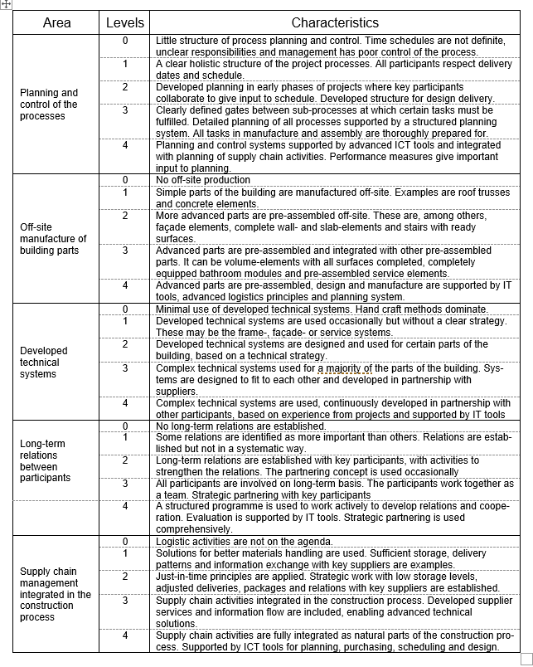
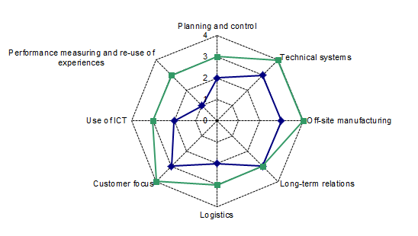
The model can be used for development planning
Lessing (2006), (2015)

Slide 19
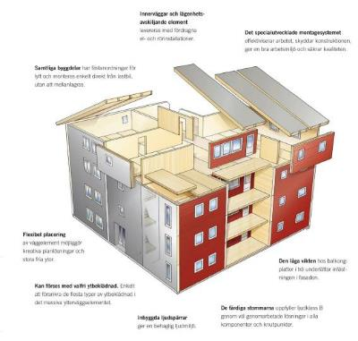
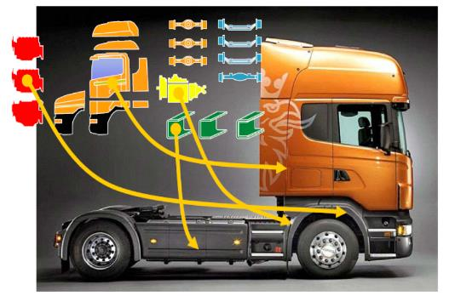
Platforms – a powerful structure
Structuring technical solutions and processes in platforms is widely adopted in other industries
Creates a backbone in the company and clarifies product limitations
Offers a systematic way to manage products, processes and projects
Pictures courtesy of Scania and Martinsons Byggsystem

Slide 20
1.0
2.0
Process
and
Project
Development of Technical platform
Development of Process platform
Separate development processes from building projects
Projects executed with pre-defined solutions
Continuous improvements based on experience
Project X1
Project X2
Project Y1
Project Y2
The projects are part of a continuous process
Lessing (2006), (2015)

Slide 21
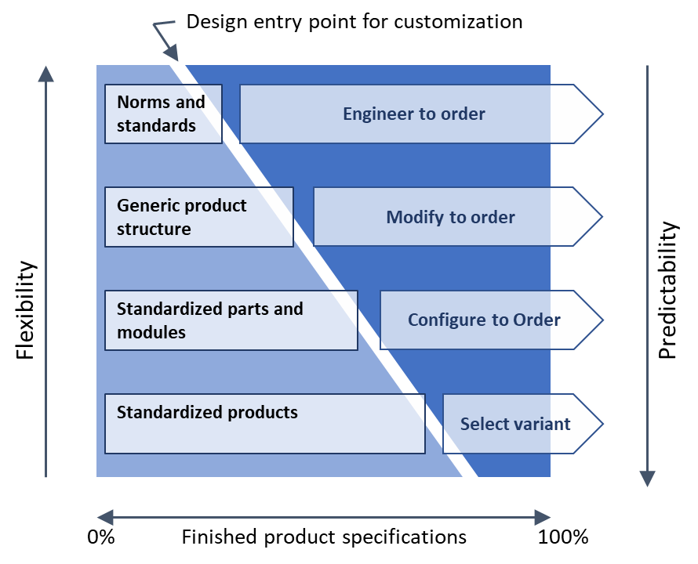
A variety of strategies for different purposes
The level of product pre-definition is strategic and affects the customer offering and the production system
The strategic choice affects the set-up of the company
Adapted from Hvam (2008), Jensen (2010)

Slide 22
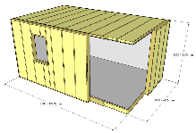
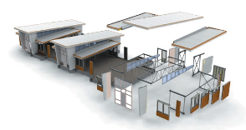
Choice of IC is strategic
Choice of IC-method is strategic and depends on what you want to build!
Kit of parts – Component strategy
Flat elements – Element strategy
Volumetric elements – Module strategy
Build in own factory or buy from suppliers?

Slide 23
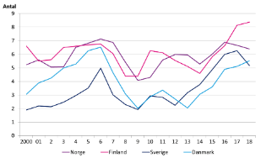
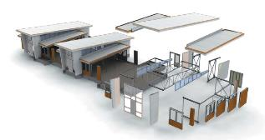
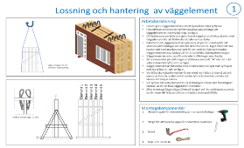
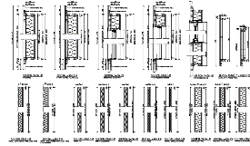
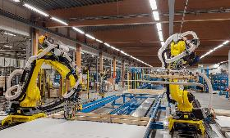
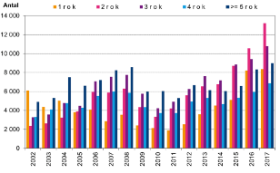
1. Customer and market insights and -selection
2. Platform strategy and
Product development
3. Production strategy and production system development

Slide 24
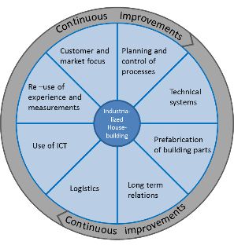
To sum up…
IC is complex and takes time
Require new (or revised) business models and strategies
Specialization is crucial
Balance investments and market volume
Integrate product- and production systems
Use customer needs as starting point
Platforms offer a structure for design and technical solutions

Slide 25
Industry examples

Slide 26
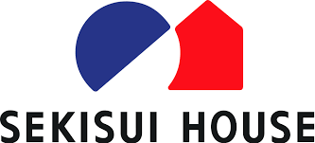
Exciting things are happening around us!
Sweden
USA
United Kingdom
Germany
The Baltic countries
Japan
Australia
Singapore
HongKong
Pakistan
Etc

Slide 27
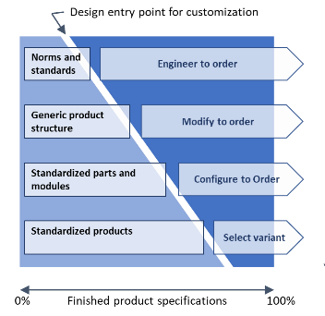
Two platform strategies dominate
1. Generic Platforms for increased efficiency
The company’s performance is improved
Technical solutions structured in platforms
Process support: BIM, Logistics, Planning
Increased use of prefabrication
Traditional contracting offering
2. New concepts are offered the market
Product offering companies
Complete customer offers
Specialization in defined product ranges
Optimized production systems

Slide 28
Sweden
Strong development since late 1990’s
Accelerated development since 2018
Big investments in companies, product platforms and factories
Industry and academic R&D support to each other
Both established construction companies and specialized IC-companies are active
Lindbäcks Bygg
Family owned company
Acts as contractor (factory and site)
Module factory since 1994
Design rules structured in Product Platform
Lean Production!
Invested 540 MSEK (60 M USD) in a new state-of-the-art module factory
Capacity: 5000 modules/year
Opened December 2017
Derome
Family owned company
Project developer & supplier
3 factories in Sweden
Design rules structured in Product Platform
New module factory in Varberg
Capacity: 2000 modules/year
Opened 2017
Moelven
Part of large timber company
Contractor
4 factories in Sweden
Design rules structured in Product Platform
Advanced module factory
High level of automation
Capacity: 2000 modules/year
Opened 2017
BoKlok
Project developer with factory
Affordable housing
Design rules structured in Product Platform
Invested 250 MSEK in state-of-the-art module factory
Capacity: 2500 modules/year
Builds only for internal projects

Slide 29
Sweden
Strong development and heavy investments in CLT
Elements for unique buildings
Powerful when used with design rules
Residential
Södra Building Systems
Large timber company
Invested 500 MSEK in a CLT factory in Varberg
Capacity of 100.000 m3 per year
Deliver to housing, industry, schools, offices etc
Stora Enso
Large multi-national timber company
Invested in a CLT factory in Grums
Capacity of 100.000 m3 per year
Deliver to housing, industry, schools, offices etc
Folkhem
Project developer focused on housing in Stockholm
Only build with wood
Large projects with CLT-structure
Partnerships with suppliers and contractors
Contractors
Small and medium sized contractors specialize in certain building systems
Leverage investments done by System owners
Partnerships with developers

Slide 30
Flexible platforms based on CLT
Pictures from www.folkhem.se
Intensive development of new platforms ongoing
Solutions for complete buildings are provided by the system owners
One example is Folkhem, specialized in building large residential buildings based on CLT Platform (flat panels)
This give:
Opportunities for new industry actors to leverage on these platforms
“Chassis” to create new concepts on
Interesting opportunities to challenge the industry

Slide 31
Folkhem, Cederhusen, Stockholm
CLT producer: Setra
Manufacturing customized flat panel elements for the project
Rapid assembly
Completely finished bathroom pods (external supplier)
Thorough planning of work flow and logistics give efficient complementing work
Photos, courtesy of Folkhem

Slide 32
Flexible platforms based on CLT – Stora Enso
Multiple platforms with a variety of buildings and concepts
Mainly the structural frame
Give a ”chassi” to configure the project upon
Residential
Offices
School
Images: www.storaenso.se

Slide 33
Germany
Both established and start-up companies
Germany and Sweden has many similarities, fx a strong manufacturing industry
Goldbeck – Large IC-company, vertical integration. Offices, parking garage, apartments, industry. Kit of parts-strategy.
Haas Fertigbau – Wood-based housing company. Element strategy.
Gropyus – Timber based start-up company.Element strategy. High level of automation. Collaboration with KUKA.
Rengli – Start-up focusing on timber based volumetric elements

Slide 34
UK
Strong development ongoing. Authorities support this.
Big investments in companies, product platforms and factories
Berkeley Group (UK)
Aiming at 4000 homes/year
Project developer, Product development and factory
One platform for the whole offering
Module manufacture based on steel structure (3000 mod/year)
Completely digital process. AI-generative design and manufacture
Legal & General (UK)
Long history in UK housing industry.
Now developing modular solutions.
Investing in Europe’s largest housing factory.
Multifamily housing.
We design and manufacture high quality, precision-engineered, energy-efficient, sustainable homes to rival conventional methods of construction.
TopHat(UK)
Newly established housing company
Manufacture modules in factories
Investment from Goldman Sachs of £75 M
Supplier to e.g. BoKlok
Building their 2nd factory
Modulous (UK & US)
Newly established housing company
Capital light
Kit of parts strategy
Digital configurator
External manufacturers
Expanding to the US

Slide 35
USA
Strong development ongoing
Big investments in companies, product platforms and factories
Plant Prefab (USA)
Established 3 factories in 8 years
Single- and Multifamily housing
Profile: Sustainability and digitalization
Mass customization and customer configuration
Partnership with high-profile architects
Digital structure through the whole company
VC-funded, partly from Amazon
Smart Home solutions part of the offering
Digital Building Components
Newly established company
Spin-off from DPR Construction
Supplier of building elements to construction projects
Very mature in digitalization
Factory in Phoenix
Steel structures manufactured with digital/automated equipment
Factory_OS
Newly established company
Factory in Vallejo, CA
Focus on modular house-building
Multi-storey residential buildings
Timber structure
Strategic partnership with Google
Acts as sub-contractor/supplier
Katerra Inc (USA)
Establishing a whole new company
Vertical integration – controlling the whole value chain
Highly digital company from start
Data driven design and planning
Mass customization
1.7 B. USD in VC-capital
Aiming at a global market
Factories in US and India
Cross Laminated Timber is major structural system

Slide 36
USA
Volumetric Building Companies
Residential buildings
Using Volumetric elements
3 factories (US + Poland)
International expansion
Juno
Founded by former Apple designer
Use CLT as its ”chassi”
Parametric digital system to create buildings as products
Nabr
Founded by architect Bjarke Ingels
Smart building system + prefabrication
High design quality
Innovative financing solutions

Slide 37
Summary
More than production!
Can’t be solved on a project level
Long-term perspective
IC requires strategic choices
The IC company’s business model depends on choice of platform strategy

Slide 38
Thank you! Questions?
Jerker.lessing@industrializedconstruction.com

Slide 39
Modulært byggeri i Danmark vs udlandet
Hvilke potentialer ser I baseret på dagens oplæg?
2 og 2 – 10 minutters snak(husk kort introduktion) og opsætning af 2 post-it (blå)
Hvilke udfordringer ser I baseret på dagens oplæg?
2 og 2 – 10 minutters snak og opsætning af 2 post-it (rød)
Fælles diskussion (plenum)
10 minutters snak om de opsatte post-its.

Slide 40
Pause (15 min)

Slide 41
Oversigt over modulbyggevirksomheder
Mayes Ali, ConTech Lab

Slide 42
Interessante virksomheder i nabolande
https://modulaertbyggeri.pory.app/

Slide 43
Hvorfor bygger vi ikke mere modulært i Danmark?
Gruppediskussion(plenum, 10 min): Emne: Hvorfor bygger vi ikke mere modulært i Danmark?
Gruppediskussion(to grupper, 15 min(kort introduktion + grønne post-it) Emne: Hvis der skal bygges mere modulært, hvad skal vi så have fokus på/ændre(brancheniveau)?
(f.eks. kulturelle holdninger, markedets modenhed, regulering via lovgivning, incitamentsstrukturer, værdikæder, strukturer mv.)
Gruppediskussion(to grupper, 25 min + gule post-it): Vision: "Danmark skal være førende land i Norden indenfor modulært byggeri" Hvordan kommer vi derhen?
Gruppediskussion(plenum, 10 min): Opsamling og præsentation

Slide 44
Afrunding og opsummering
Opsamling af hovedpunkterne fra diskussionerne
Whats next
Workshop 2: (25 oktober) dykke ned i de arbejdsprocesser og kontraktuelle forhold, der er forbundet med modulært byggeri og sammenligne med, hvad vi kender fra traditionelt byggeri.
Workshop 3: (15 november) dykke ned i forretningsværdien af at bygge modulært og blive klogere på Co2-regnskab

